Slide 1
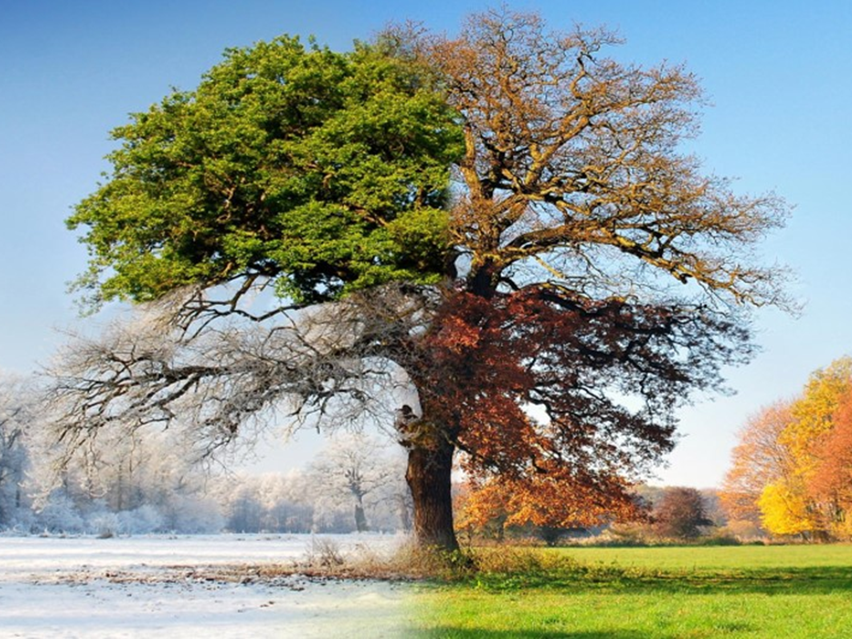
Reasons For the Seasons
Vocabulary
Eccentricity
Obliquity
Precession
Insolation
Milankovitch Cycles
Axial precession
Orbital precession
Solstice
Equinox
Ellipse

Slide 2
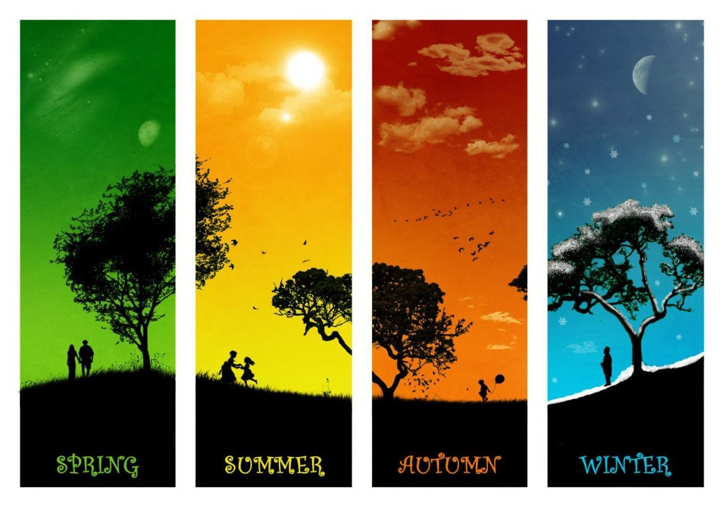
Seasons
You know that places experience differences in climate (temps and rain) throughout the year, broken down into 4 seasons in a yearly cycle.
What are the 4 seasons?
What are the differences between the seasons?
Our question now is “what is responsible for the seasons?”

Slide 3
What causes the Seasons?
Different Seasons and their characteristics are determined primarily by how much direct sunlight a place gets.
Even though every place on earth gets sunlight…
not all places get the same sunlight in terms of the number of hours and its intensity.
Why????!!!!

Slide 4
Variation in Sunlight in different parts of the world
Sunlight varies in just about every place on Earth:
  Tropical (about 30°N - 30°S): varies by minutes from season to season
    Ecuador has nearly 12 hours of sunlight, 12 hours of night every day
  Temperate regions (30°N/S - 60°N/S): varies by a few hours from season to season
    Phoenix: 10 hours of sunlight in winter, 14.5 in summer
  Polar/Artic (roughly 60°N/S to the north and south poles): varies significantly from having one or two hours of sun to months when the sun never sets!
    24 hours summers, 0 hours winter

Slide 5
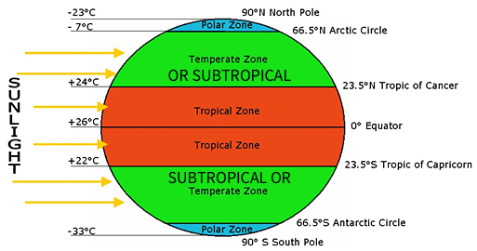

The suns rays and the
Three Specific Major Climate Zones

Slide 6

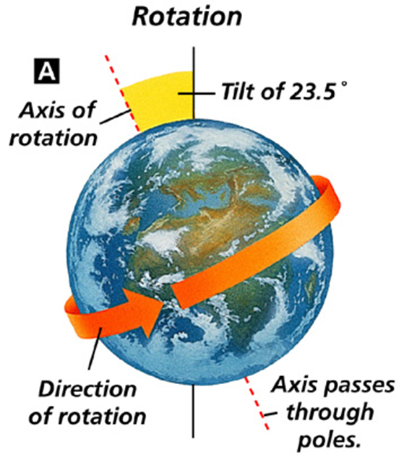
What Causes the Seasons?
If the sun hit all parts of the earth directly, every place would be close to the same temperature.
But temperatures are always different and constantly changing because our planet, simultaneously…
Is Round so that the sun’s rays spread out the farther from the equator you move.
Is In a constant 24-hr rotation so the sunlight shines on any one place for a short time, which gradually shifts west.
Is tilted on an axis so that the sunlight is shared unequally between the northern and southern hemispheres.
Maintains its tilt as it Orbits the sun, which flips the hemisphere of the earth that is receiving the most sun.

Slide 7
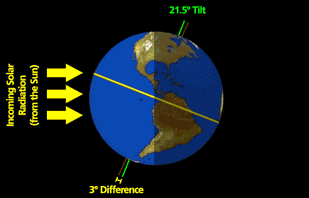
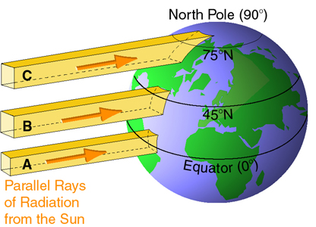
Our (round) Planet
It is no surprise the our planet is round (sorry flat-earthers).
This roundness causes an unequal distribution of the sun’s rays.
  See A, B, & C.
What do you think results from the sun’s rays being spread out?
What do you think would be the effect?

Slide 8
Disbursing sunlight
The amount of sunlight within the entire yellow shape is the same, but it’s spread out over a larger area effectively reducing the amount of energy received.
C
B
A

Slide 9
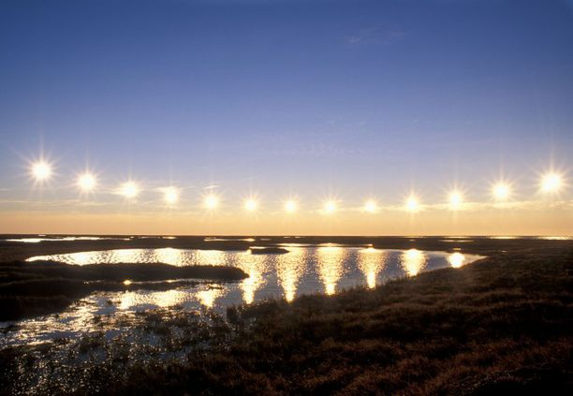
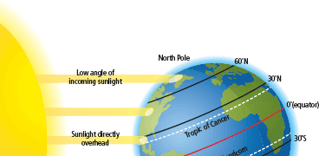
Unequal distribution of the Sun’s Rays
For Longyearbyen, Norway this means that from October 27 through to February 14, it’s always night time. Conversely, from April 19 through August 23, there’s 95 days of midnight sun.
Depending on the time of year, the tropic of cancer (30°N) or tropic of Capricorn (30°S) receives the most direct sunlight during the day and this doesn’t change much.
At higher latitudes the effect of the suns rays becomes less direct and more spread out.
Above 66.5°N or S, this becomes so exaggerated that in summer the hemisphere will experience 24-hours of weak sunlight, or in winter will experience 24-hour darkness.

Slide 10
Our (round) Planet’s Rotation
It is also no surprise the our planet spins, called rotation.
It takes 24-hours for our planet to make one full rotation.
  Meaning, it takes 24-hr for a spot on the Earth facing the sun to face the sun again.
This gives us day when we’re facing the sun and night when we’re not.
The earth rotates toward the east.
the curvature and rotation of the earth creates variable insolation.
Insolation: The amount of solar radiation any given area is exposed to.

Slide 11
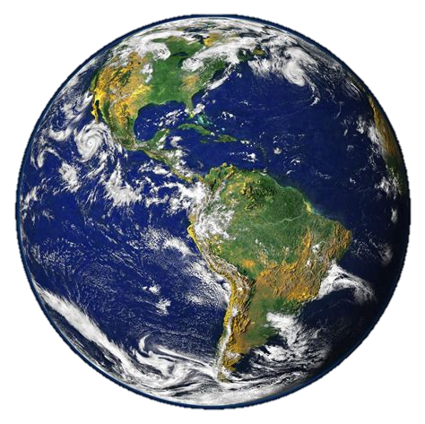
Earth’s Orbit
It is also not a surprise that our round, rotating planet also orbits around the sun.
There are specifics that we need to discuss to better understand the seasonal changes our planet goes through.

Slide 12
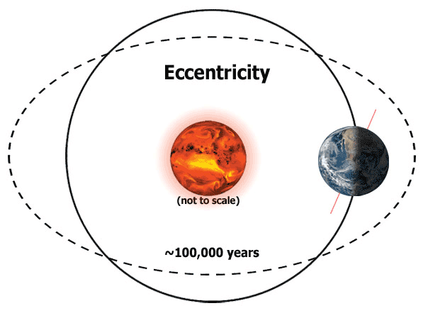
Question: What do you think? Which path does our planet take as it orbits the sun? is it a circular path or elliptical?
The plane of orbit is the path that the earth takes as it travels through space around the sun.
Our planet’s orbital Path is an imperfect Ellipse, but this changes.
Eccentricity is the deviation of a curve or orbit from a perfect circle
referring to the shape of the earth’s orbit, its eccentricity fluctuates slowly between being almost circular to more elliptical.
It takes about 100,000 years for is to make one full cycle.
Zero Eccentricity means a perfect circle
As eccentricity increases, the ellipse flattens.

Slide 13
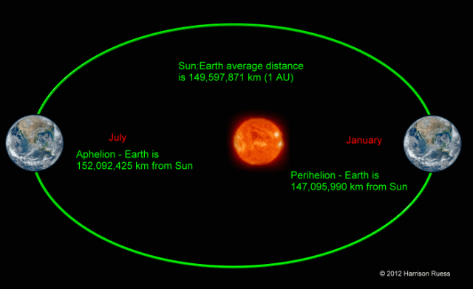
Question: What do you think? Is the distance from the Earth to the Sun Constant or does it change?
The elliptical path of the earth’s orbit is not equal.
It’s actually a slightly offset orbit and creates 2 particular checkpoints.
The average of these two distances is 1au = 150 million miles.
Aphelion: The point when the earth is the farthest from the sun.
Perihelion: The point when the earth is closest to the sun.

Slide 14
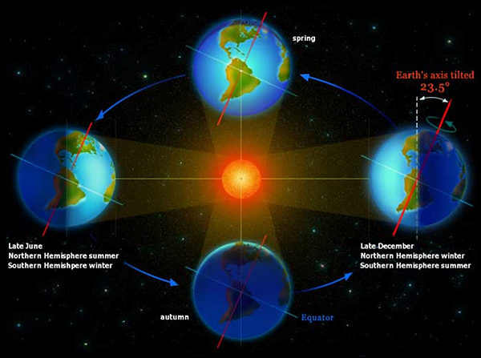
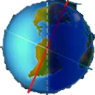
Question: Is the earth straight up and down in its orbit?
Think of Earth’s Orbit as a huge invisible disk that the earth rotates on.
The rotation of the earth is around its axis.
The earth’s tilt relative to the plane of orbit is called the obliquity.
This axis is not aligned or perpendicular with the plane of orbit.
The Earth’s tilt fluctuates between 24° (max) and 21.5° (min) “off square”.
Right now it’s 23.5° and growing.
Follow up Question: What would happen if the earth was not tilted?
Equator
Plane of Orbit

Slide 15
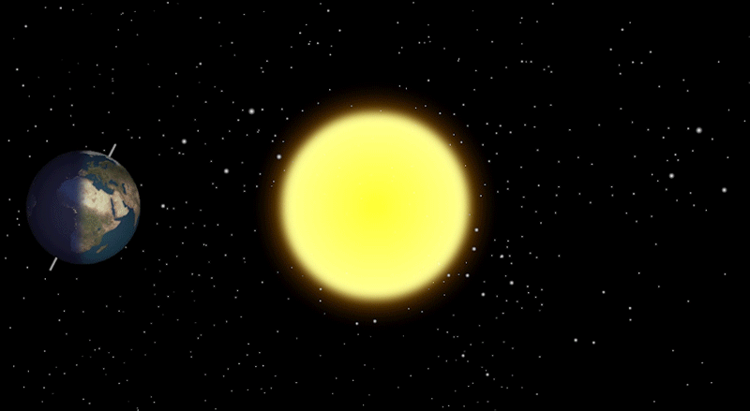
Our Planet’s Tilt: Throughout the year
Since the earth maintains its tilt throughout its orbit (which takes one calendar year to complete), each hemisphere spends half of the year experiencing more sun.
The orbit features 4 distinct checkpoints
2 equinoxes and 2 solstices.

Slide 16
Equinoxes and solstices
Solstices are days when the sun’s rays reach the farthest north and south.
  caused by the axis being tilted either towards or away from the sun.
  The summer solstice is close to June 21 and marks the longest day in the northern hemisphere.
  The winter solstice is close to December 21 and marks the shortest day in the northern hemisphere
  Reverse these for the southern hemisphere
Equinoxes are days when the axis is perpendicular to the sun’s rays.
  The day and night everyplace on earth is the same length of time.
  The spring equinox occurs close to march 21.
  The autumn equinox occurs close to September 21.

Slide 17
Equinoxes and solstices
The Earth’s axis runs straight through the Earth, from North pole to South pole.
Depending on whether the axis is tilted towards, away, or aligned with the sun will determine whether the Earth is positioned in an equinox or solstice.

Slide 18
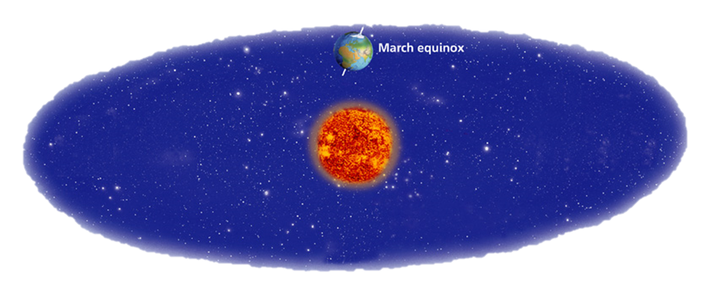
Vernal Equinox
Roughly March 21 marks what is called the Vernal Equinox.
The Earth’s axis is perfectly perpendicular to the sun’s rays. This is also called the Spring Equinox.

Slide 19
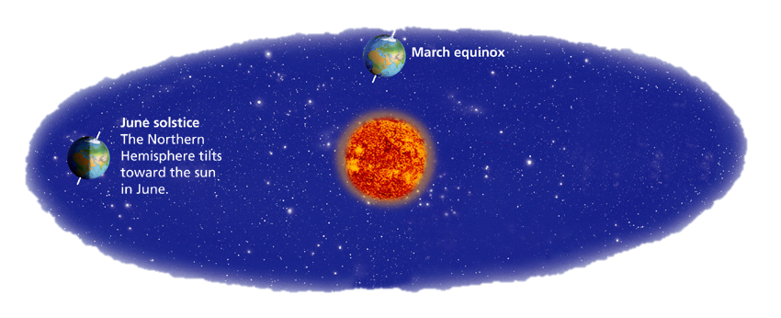
Summer Solstice
Roughly June 21, the longest day of the Northern Hemisphere, marks the Summer Solstice.
At this time, the Earth’s northern axis is titled toward the sun.

Slide 20
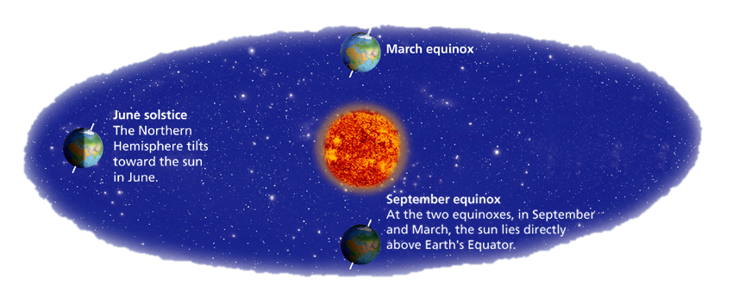
Autumnal Equinox
Roughly September 21 marks what is called the Autumnal Equinox.
The Earth’s axis is again perfectly perpendicular to the sun’s rays.

Slide 21
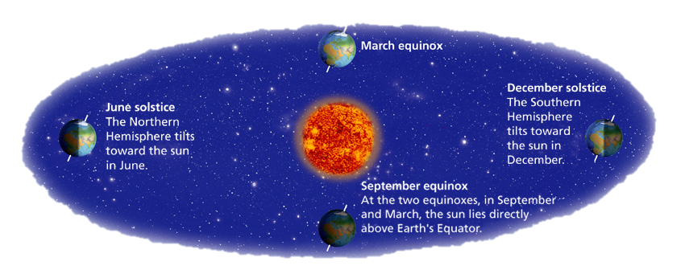
Winter Solstice
Roughly December 21, the shortest day of the Northern Hemisphere, marks the Winter Solstice.
At this time, the Earth’s southern axis is titled toward the sun.

Slide 22
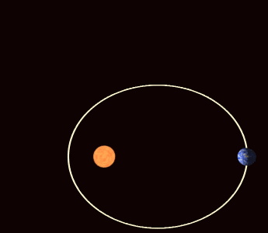
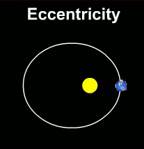
Question: What do you think? Does the earth maintain the same orbit all the time? (meaning, if you could mark a spot in space, next year when the earth reaches that date in orbit will it be in the same place in space?)
Apsidal Precession

Slide 23
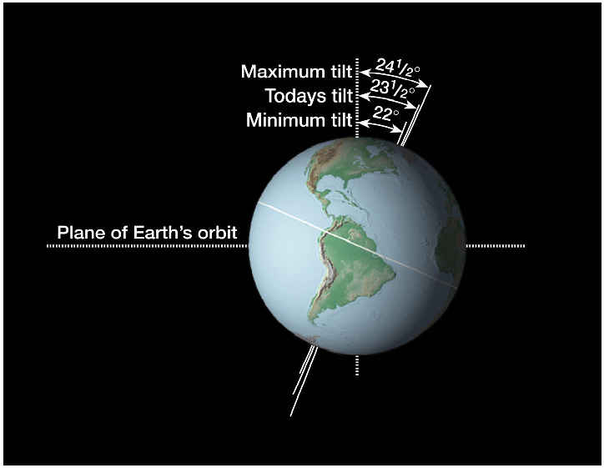
Question: Does the angle of Earth’s tilt remain constant?
Our planet is round and, as seen, also rotates, is tilted, and is in an elliptical orbit.
There is a specific angle that the earth is titled on, called it’s axial Tilt.
Today this tilt is 23.5°, but this actually fluctuates between about 22° and 24.5°.
It takes about 41,000 years for the axis to make one cycle.

Slide 24

Question: What do you think? If the earth is tilted at 23.5° today, what will the impact on Phoenix weather be when the tilt adjusts to 21.5°? (think about the sun’s angle)
There is a shift in the sunlight’s direct path from the Sun to the Earth.
When the earth is at it’s minimum tilt then Phoenix will get more direct sunlight and get… hotter!

Slide 25
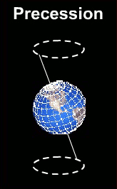
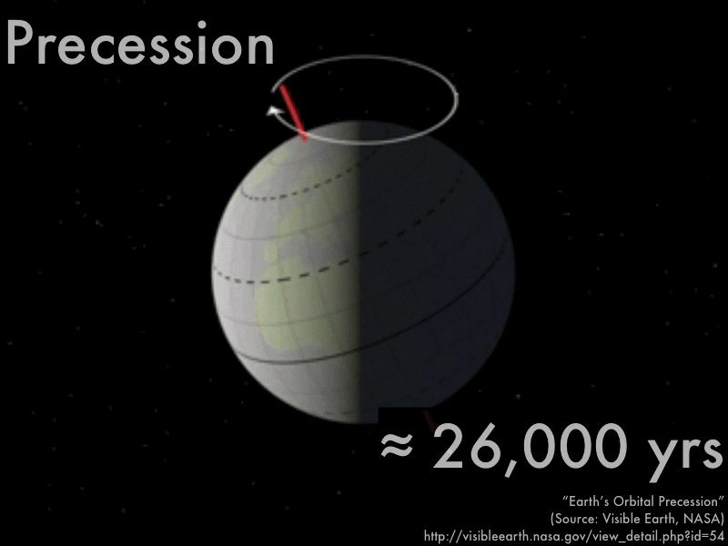
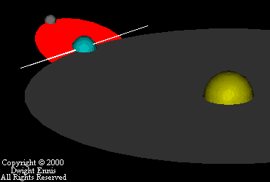
Earth’s Tilt… Axial Precession
The tilt of the earth, called its axial tilt, fluctuates.
But remember, the earth is spinning as it is tilted.
In addition to the spin and tilt, the earth wobbles around its axis called axial precession.
Earth’s precession is much like how a top spins.

Slide 26
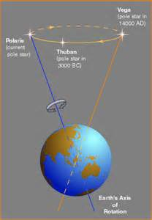
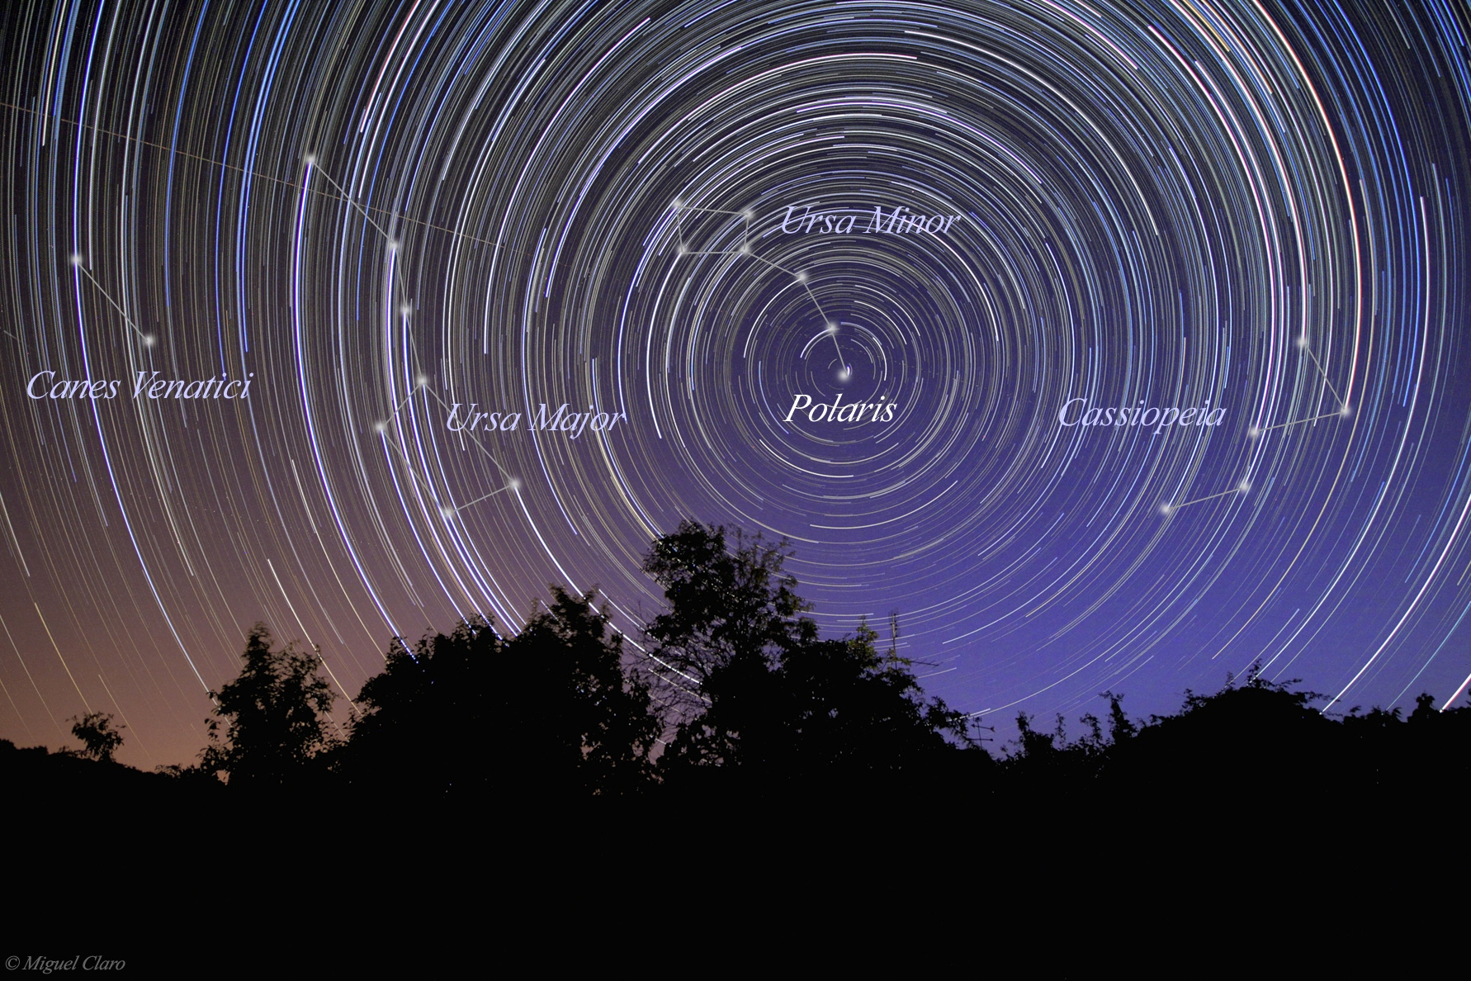
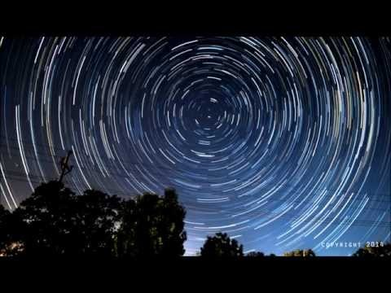
The Effect of Precession
The effect of precession has had a real impact on earth.
Axial Precession changes the designation of the “north star” through time.
This has slowly changed from the star vega thru Thuban (4th to 2nd millennium BC) to Polaris.
Through time lapse we can see how the north star can appear to be a stationary place in space to navigate by.

Slide 27
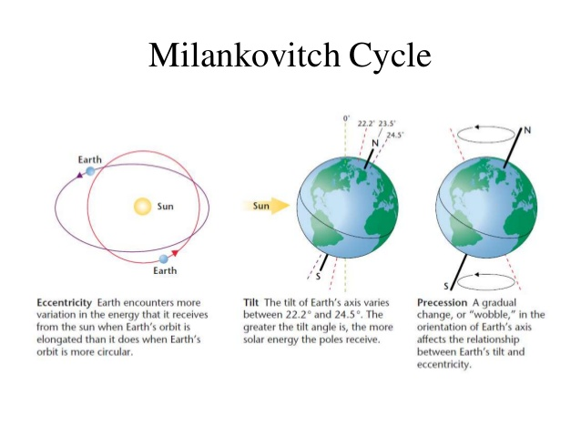
Milankovitch Cycle
Milankovitch theory describes the collective effects of changes in the Earth's movements upon its climate.
All three factors…
Earth’s eccentricity +
Earth’s Obliquity (Axial Tilt) +
Earth’s precession +
= 1 milankovitch cycle.
Periodicity: 100,000 years
=
Eccentricity + Tilt + Precession

Slide 28
Question: What do you think? What would be the climate result in north America when…
1. the earth’s eccentricity is maxed out (largest elliptical orbit)
2. the earth’s tilt is maxed (24.5° points the N. pole away) and
3. the earth’s precession is maxed farthest away from the sun (the wobble pushes the N. pole farther away)?
MAJOR ICE AGE!!!
“SNOWBALL EARTH”
Discuss with individuals around you for 2 minutes. Come up with 2 consequences (at least one about the amount of sunlight and one about temperatures)

Slide 29
Conclusion
Today you’ve learned a lot about the characteristics of the earth’s tilt, rotation, and orbit and how these effect earth’s seasons.
Remember:
the features of the earth’s curvature and rotation affects how the sun’s rays affect Earth’s seasons. (how it causes insolation to decrease as you increase latitude and from day to night)
The earth’s tilt (how it causes one hemisphere to receive more sunlight half of the year, creating summer on one hemisphere at the same time winter is happening in the other and how this changes slightly over time) means that the Northern and Southern hemispheres get the opposite weather.
The earth’s orbit fluctuates between being more elliptical to being circular (affecting how close to the sun we are at aphelion and perihelion)
The axis of rotation changes its orientation with regard to the sun’s rays giving what’s called precession.
All together, Earth’s eccentricity, its obliquity, and Precession all contribute to a 100,000 year cycle called a Milankovitch Cycle.

Slide 30
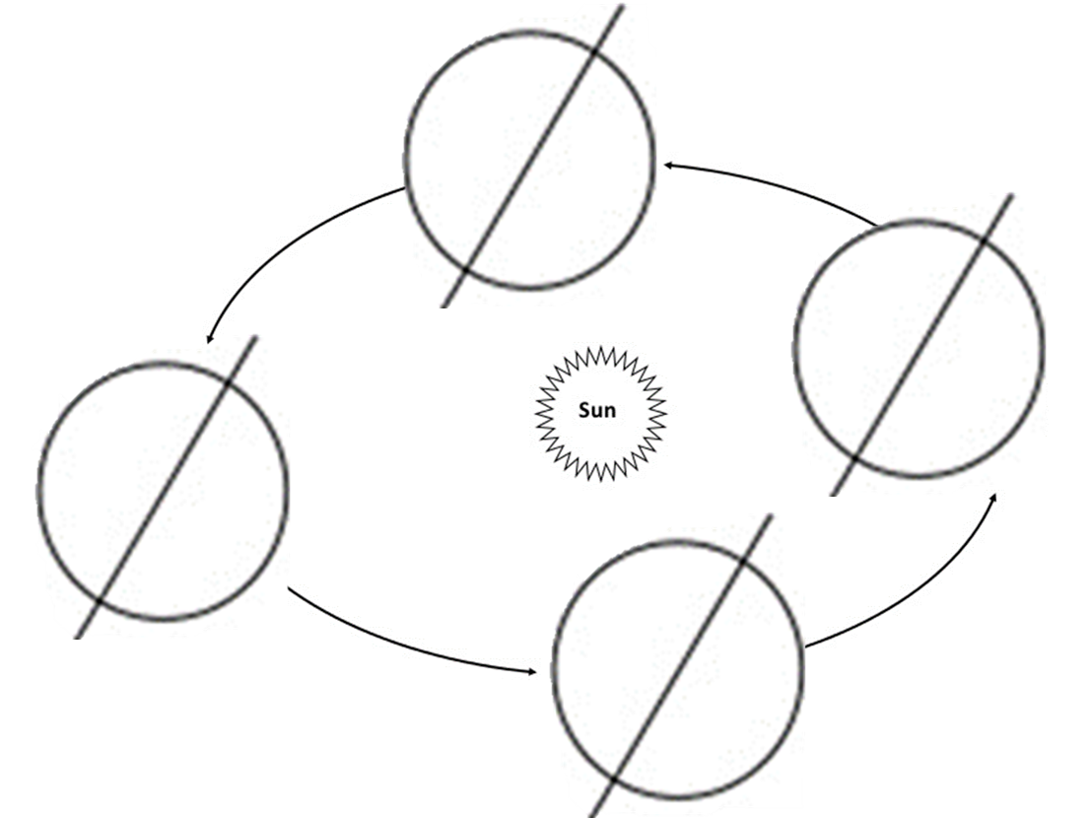
Independent Practice
Motion of the Earth & Seasons. (20pts). Due Friday
Questions 1-5: Use common sense to determine how sunlight causes half the Earth to be in sun and the other half to be in shade.
Think about this for 5 minutes, then we’ll discuss.
Once we agree on the shading, use books and notes to label the climate zones and major latitude lines.
Activity Questions:Using the same book pages you used for the reading activity (pgs 767-771) & the handout to complete the activities.

